Slide 1


Twitter Employees charged with spying for Saudi Arabia
By: Jason Loo

Slide 2

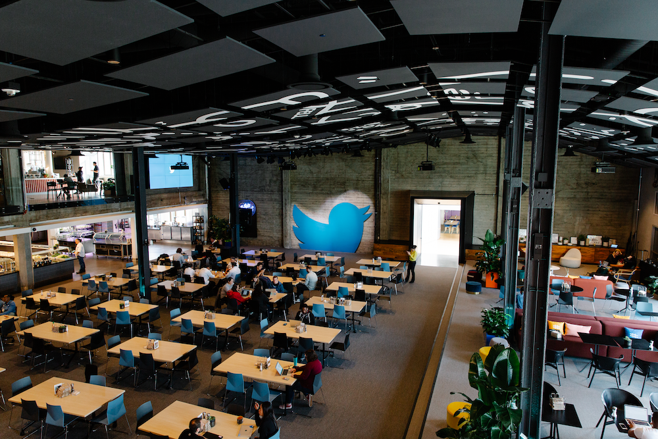
Background information
Twitter
A social media company located in San Francisco
Epically popular with celebrities, policymakers and politicians
Like any social media company, in order to access their “free” service, you must give up personal information like name, an email, and locations
Notes:
A microblogging system that lets the user promote ideas quickly. It especially became popular after many policymakers, politicians and celebrities use the platform to casually communicate with those who are following them.

Slide 3

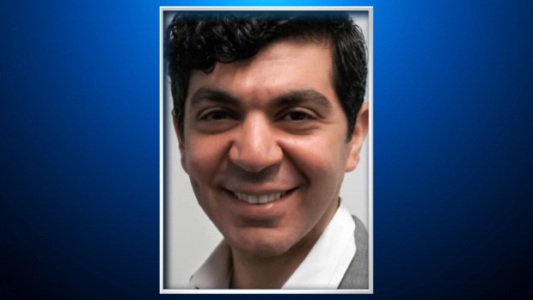
Twitter employee #1: Ahmad Abouammo
In 2014 twitter media manager, Ahmad Abouammo, was tasked with assigning a particular Saudi news journalist a verified icon on their profile.
Because of this, he became familiar with the firm’s PR, the Saudi embassy, and Almutaiari( who claimed to represent the Saudi royal family)
However eventually, an unnamed Saudi foreign official was cultivating a way to contact this particular twitter manager to hand over information.
This particular official was linked with Almutaiari who was able to obtain Abouammo’s email

Slide 4
Ahmad Abouammo cont.
In December 2014, Abouammo attented a Twitter conference in London where he met with this particular official and was gifted a $20,000 watch which he later tried to sell on craigslist the next month
By mid 2014, Abouammo was using his position to gather internal records of specific politicians and celebrities, and leaked them to this foreign official, however these are alleged.
Information included email and phone contacts in addition to personal information
At least one of the accounts belonged to a well known critic of the Saudi family
Later in May 2015, Abouammo eventually quit his position to move to Seattle to start working at Amazon, before co-founding a marketing company in the same area.
According to prosecutors, he received $100,000 via a wire transfer to an off shore bank account in Lebanon
According to Abouammo, this was made doing contract work, and provided an invoice which FBI agents believe to be fake

Slide 5
Twitter employee #2:Ali Alzabrah
In February 2015, the same alleged Royal Family PR, Almutaiari, spoke with Ali Alzabrah who was a site reliability engineer over the phone
After they both met in Washinton DC, Alzabrah siphoned internal records of about 6,000 twitter accounts
They included flagged law enforcement and were sent to Almutaiari
One account in particular belonged to Omar Abdulaziz, an activist who was friends with Washington Post columnist Jamal Khashoggi
Khashoggi was a well known critic of the royal family and advocated for free speech
Unfortunately in 2018 Khashoggi was assassinated by orders of Saudi Crown Prince Mohammed bin Salman
In December of 2015 Alzabrah returned to Saudi Arabia and began working for the royal family
He currently holds a B1/B2 visa but has not been back to America since

Slide 6
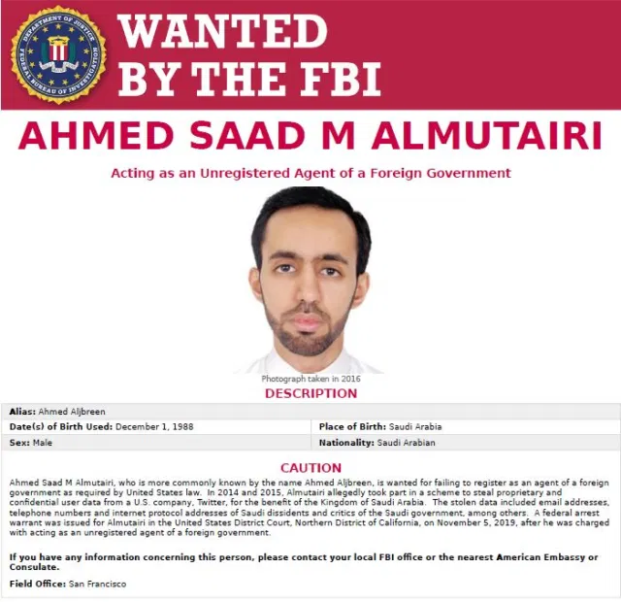
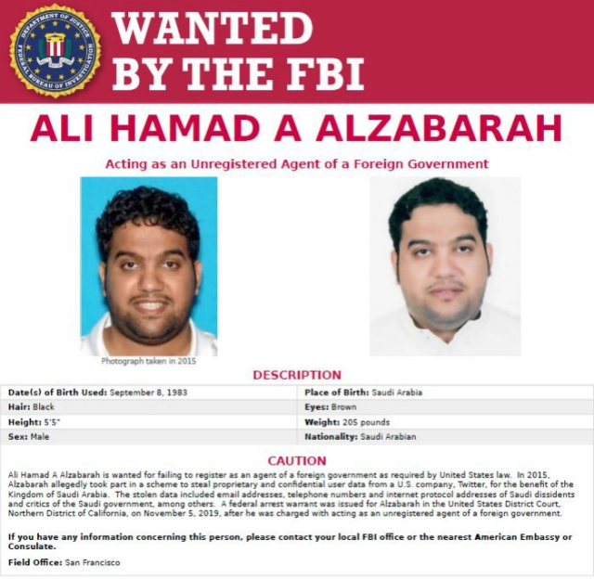
What has been happening since…
Both Ahmed Almutairi and Ali Alzabarah are thought to be residing in Saudi Arabia at this time
These are the wanted posters the FBI have published
If convicted, all 3 of these suspects face 10 years and a $250,000 fine
Currently Abouammo faces an additional 20 years and $250,000 for destrying, and altering records

Slide 7

Spies targeting government officials as well
Some examples of defecting:
Snowden case (2013)
Former US Air Force member defecting to Iran
In addition to social media companies, according to the FBI, spies are using social media to contact government contractors as well (usually to convince them to defect from the United States)
Unfortunately, sometimes what happens is that foreign intelligence will use social engineering to persuade individuals to give up valuable information
This could be like posing as a long-time friend for months to years to convince government employees that they are legitimate

Slide 8
Ways governments are attempting to regulate privacy
California Consumer Privacy Act was passed and signed January 1st 2020
Businesses must disclose what information they collect and what business they plan on using it for
Companies must comply with official consumer requests to delete data
Consumers are allowed to opt out of data being sold, and businesses cant retaliate
Businesses are allowed to offer financial incentives for collecting data
California authorities are allowed to fine companies for violating the terms
Illinois Biometic Information Privacy Act
Biometic: a way to measuring and creating a statistical analysis on an individual’s physical and behavioral characteristics
Usually used to verify identity, security access, or assist with health plans
Companies must obtain consent from individuals if company intends to collect or disclose personal biometric identifiers
Destroy biometric identifiers in timely manner
Securely store biometric identifiers

Slide 9
Resources
https://www.zdnet.com/article/game-of-thrones-hacker-worked-with-us-defector-to-hack-air-force-employees-for-iran/
https://www.zdnet.com/article/fbi-warning-foreign-spies-using-social-media-to-target-government-contractors/
https://sanfrancisco.cbslocal.com/2019/11/07/fbi-releases-wanted-posters-for-saudi-suspects-in-twitter-spying-case/
https://www.natlawreview.com/article/illinois-biometric-information-privacy-act-bipa-when-will-companies-heed-warning
https://techcrunch.com/2020/01/01/the-california-consumer-privacy-act-officially-takes-effect-today/
https://www.brennancenter.org/our-work/research-reports/government-monitoring-social-media-legal-and-policy-challenges
https://www.sans.org/newsletters/newsbites/xxi/88
https://www.zdnet.com/article/saudi-arabia-allegedly-recruited-former-twitter-employees-to-access-user-data/
https://www.theregister.com/2019/11/07/twitter_employees_saudi_spy/
https://www.washingtonpost.com/national-security/former-twitter-employees-charged-with-spying-for-saudi-arabia-by-digging-into-the-accounts-of-kingdom-critics/2019/11/06/2e9593da-00a0-11ea-8bab-0fc209e065a8_story.html

